Slide 1
Berkeley DB
By Shelby Hendrickx & Lucas van der Laan

Slide 2
Introduction
Data Model
Principles of Berkeley DB
Economics
Demo
Notes:
Datamodel behind berkeleydb
What berkeleydb is all about
The current economics of berkeley d
And finally a demo

Slide 3
Data Model
Key-Value Store
Pros:
Simplistic
Flexible
Scalable
Performance
Cons:
No support for complicated searches
Not OOP
Lack of standardization (e.g. no standards for keys)
Notes:
What is key value ?
Simple queries because one on one mapping,
Flex -> can be any key and any value
Scal -> supports huge data
Perf -> no overhead like in relat. Db
Lack of stadnard -> next slide

Slide 4
Data Model
Key-Value Store
Key | Value
John | johndoe@hotmail.com
Mammals | Bear, Cat, Dog, Elk, Fox
12984 | { first: “John”, last: “Doe”, age: “5” }
K1 | AAA, 2, 01/01/2015
0x352CDF3F | Img://cat.jpg, 120000, 01042019, john, 420
Notes:
Keys and values can be anything
Very different from relational DB.
RDB has pre-defined data struct, because it consists of tables with well defined DATA TYPES, key-value -> treats all the data as a single collection, with different fields for every record
A Key-value store -> much more performant, far less memory

Slide 5
Data Model
Berkeley DB Specifics
Store Type
Ordered Key-Value Store
Size
2³² bytes key <–> 2³² bytes value ( around 4.2GB )
Database type
Embedded
Notes:
BerkeleyDB uses so-called Ordered key-value store -> advanced because it is sorted and makes easier to find data
Huge keys and values
Since time to copy a record is proportional to size, Berkeley interfaces allow for partial record retrieval where it only gets the bytes that are necessary
Embedded into application -> uses api calls

Slide 6
When to use
When you can predict data access patterns
Many customers -> don't have to buy, install, manage separate DB
End users are non-sophisticated administrators
Notes:
- especially when simple key-value queries AND because the queries can be coded up once -> will run very quickly because there is no SQL to parse and execute.
- because it is embedded into application

Slide 7
When NOT to use
Application needs different services
You can't predict how you need to access your data
Complex SQL Queries (non key-value queries)
Notes:
Can't predict -> has to be programmed ahead of time before database and application are created

Slide 8
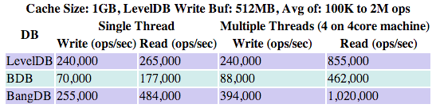
Principles of Berkeley DB
ACID
Performance
Querying
Limitations
http://highscalability.com/blog/2012/11/29/performance-data-for-leveldb-berkley-db-and-bangdb-for-rando.html
Notes:
ACID: Configured in the application (See transaction config

Slide 9
Principles of Berkeley DB
ACID
Atomicity
Consistency
Integrity
Durability
Notes:
According to oracle, completely ACID compliant.
Atomicity is guaranteed by using locks and transactions, if the transaction fails, no data changed
Consistency guaranteed, unless database configured to disable
Durability is configured in the application

Slide 10
Principles of Berkeley DB
Querying
Key-Data
No SQL
Notes:
Explain in demo
Looks for keys and returns data
Not direct SQL, but comparable API calls

Slide 11
Principles of Berkeley DB
Limitations
Minimum page size: 512 bytes
Maximum page size: 65.536 bytes
Minimum-maximum database file size: 2^41 (2 terabytes)
Maximum database file size: 2^48 (256 terabytes)
Largest key/data item is 2^32 bytes ( around 4.2GB )
Maximum Btree depth: 255

Slide 12



Economics
Famous Case
Market Share
Notes:
Amazon user customization
Bitcoin Core, until Bitcoin Core 0.8, changed to LevelDB
Previously Subversion

Slide 13
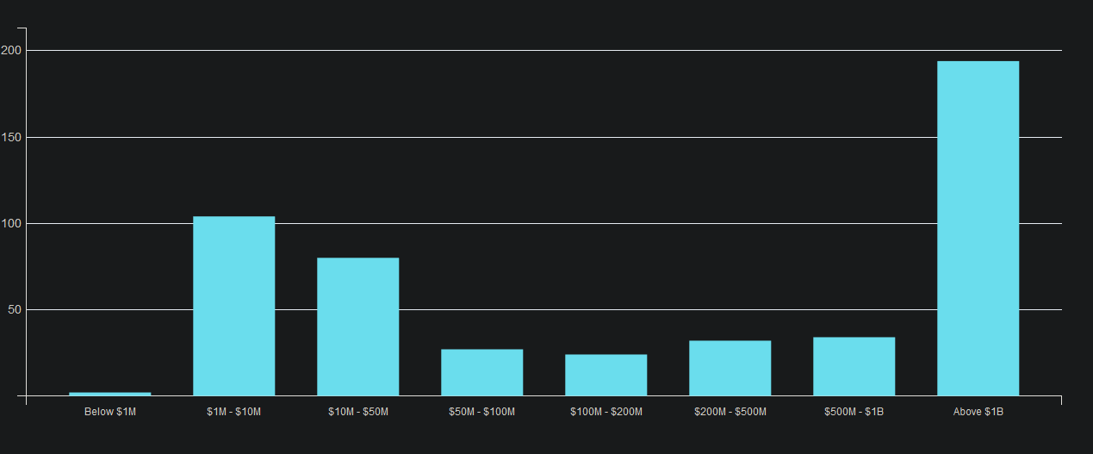
Economics
14th key-value - https://db-engines.com/en/ranking/key-value+store
88th overall - https://db-engines.com/en/ranking
first released in 1994
1996 – 2006 Sleepycat Software
Acquired in 2006 by Oracle
Oracle Berkeley DB
Berkeley DB Java Edition
Berkeley DB XML.
https://discovery.hgdata.com/product/oracle-berkeley-db
Notes:
Sleepycat abolished 2006

Slide 14
Demo

